Slide 1
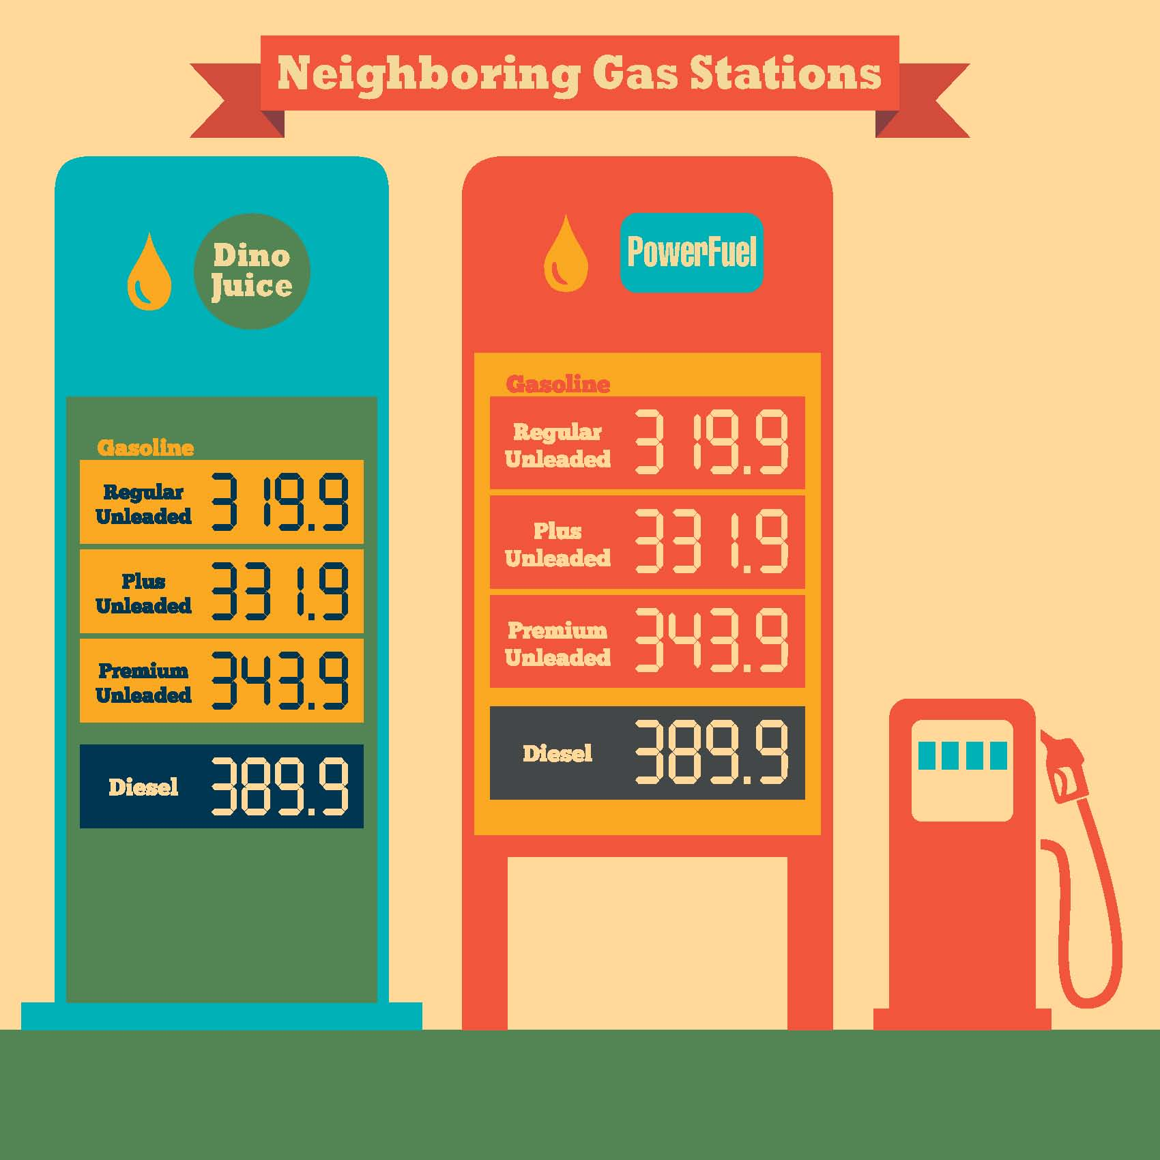
Neighborly Competitors?
One Friday morning, Jack left home with a nearly empty gas tank. He drove out of his neighborhood, turned left onto Clifton Road and drove five miles without encountering a gas station.
Then he arrived at the intersection of Clifton and Main, where he encountered two gas stations – advertising the exact same price.
He shook his head and muttered: “What we need is more competition in this town! And a station closer to my house!”
Notes:
Image source: www.reporternews.com (photographer Brian Schmidt)

Slide 2
Perfectly Competitive
Many buyers and sellers
Low barriers to entry
Identical products
Firms have no influence on the price of the good
Imperfectly Competitive
Few sellers
High barriers to entry
Identical or differentiated products
Firms can influence price of the good

Slide 3
The Prisoner’s Dilemma
Curly’s Strategies
 | Confess | Don’t Confess
Confess | 5 yrs, 5 yrs | 1 yr, 10 yrs
Don’t Confess | 10 yrs, 1 yr | 2 yrs, 2 yrs
Moe’s Strategies

Slide 4
The Prisoner’s Dilemma
Curly’s Strategies
 | Confess | Don’t Confess
Confess | 5 yrs, 5 yrs | 1 yr, 10 yrs
Don’t Confess | 10 yrs, 1 yr | 2 yrs, 2 yrs
Moe’s Strategies

Slide 5
The Prisoner’s Dilemma
Curly’s Strategies
 | Confess | Don’t Confess
Confess | 5 yrs, 5 yrs | 1 yr, 10 yrs
Don’t Confess | 10 yrs, 1 yr | 2 yrs, 2 yrs
Moe’s Strategies

Slide 6
The Prisoner’s Dilemma
Curly’s Strategies
 | Confess | Don’t Confess
Confess | 5 yrs, 5 yrs | 1 yr, 10 yrs
Don’t Confess | 10 yrs, 1 yr | 2 yrs, 2 yrs
Moe’s Strategies

Slide 7
The Prisoner’s Dilemma
Curly’s Strategies
 | Confess | Don’t Confess
Confess | 5 yrs, 5 yrs | 1 yr, 10 yrs
Don’t Confess | 10 yrs, 1 yr | 2 yrs, 2 yrs
Moe’s Strategies

Slide 8
The Prisoner’s Dilemma
Curly’s Strategies
 | Confess | Don’t Confess
Confess | 5 yrs, 5 yrs | 1 yr, 10 yrs
Don’t Confess | 10 yrs, 1 yr | 2 yrs, 2 yrs
Moe’s Strategies

Slide 9
The Prisoner’s Dilemma
Curly’s Strategies
 | Confess | Don’t Confess
Confess | 5 yrs, 5 yrs | 1 yr, 10 yrs
Don’t Confess | 10 yrs, 1 yr | 2 yrs, 2 yrs
Moe’s Strategies

Slide 10
The Prisoner’s Dilemma
Curly’s Strategies
 | Confess | Don’t Confess
Confess | 5 yrs, 5 yrs | 1 yr, 10 yrs
Don’t Confess | 10 yrs, 1 yr | 2 yrs, 2 yrs
Moe’s Strategies

Slide 11
Game Theory Terms
Game
Strategy
Payoff
Dominant strategy
Nash equilibrium
Collusion

Slide 12
Dueling Gas Stations
Notes:
Same image as Slide 2

Slide 13
Dueling Gas Stations
Alex
 | High Price | Low Price
High Price | $1000, $1000 | $100, $1200
Low Price | $1200, $100 | $250, $250
Pat

Slide 14
Split or Steal?
Player Two
 | Split | Steal
Split | 5, 5 | 0, 10
Steal | 10, 0 | 1, 1
Player One

Slide 15
Coke vs. Pepsi Launch a New Flavor?
Pepsi
 | Launch Mango Pepsi | Don’t Launch
Launch Mango Coke | -50, -50 | 100, -25
Don’t Launch | -25, 100 | 0, 0
Coke
Grid numbers represent changes in profits.

